Slide 1
Case Study II: Evaluating the Efficiency of Bus Route Adjustments: City bus No. 56
GCAP3226 2026/02/04

Slide 2
Structure of Case Study II
  Background
  Simulation design
  Random component in the simulation
  Results Interpretation
  Enquiries (with Transport Department)
  In-class Exercise

Slide 3
Background
Franchised bus companies submit annual Bus Route Planning Programmes to the Transport Department (TD)
The TD reviews proposals, consults with relevant District Councils (particularly for major changes)
Implementation often begins on a temporary basis, allowing up to 24 months of operation without permanent legislative changes.
Legislative procedures are required when route changes need to be made permanent beyond the 24-month temporary period.

Slide 4
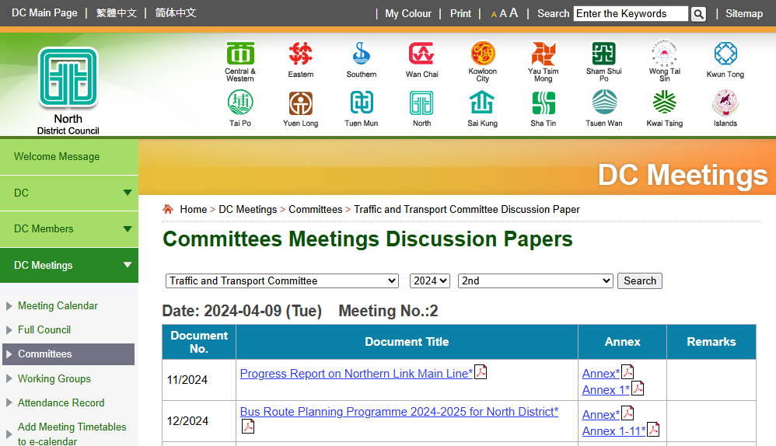
Bus route planning programme

Slide 5
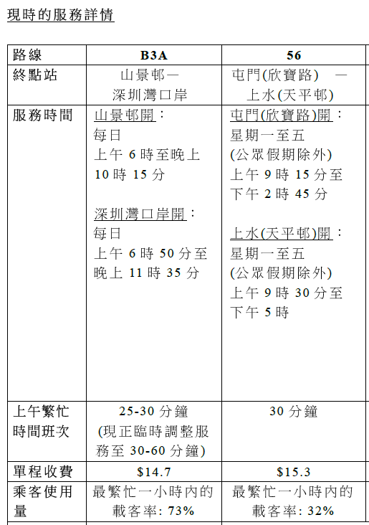
Criteria for Increasing Bus Frequency
“For individual bus routes, if the passenger load factor reaches 90% during the busiest half-hour and 75% during the busiest hour of peak periods, or 60% during the busiest hour of off-peak periods, the department and the franchised bus company will consider increasing the service frequency.”
(2024)
Bus route planning program 2024-2025 for North District

Slide 6
Questions
The passenger load factor of City Bus No. 56, as reported in the proposal, is 32% during the busiest hour (before adjustment). However, it is unclear:
How this passenger load factor is defined
When the busiest hour occurs
Whether the 32% represents an average across different stops and shifts
How an increase in bus frequency is justified given a passenger load factor of 32%

Slide 7
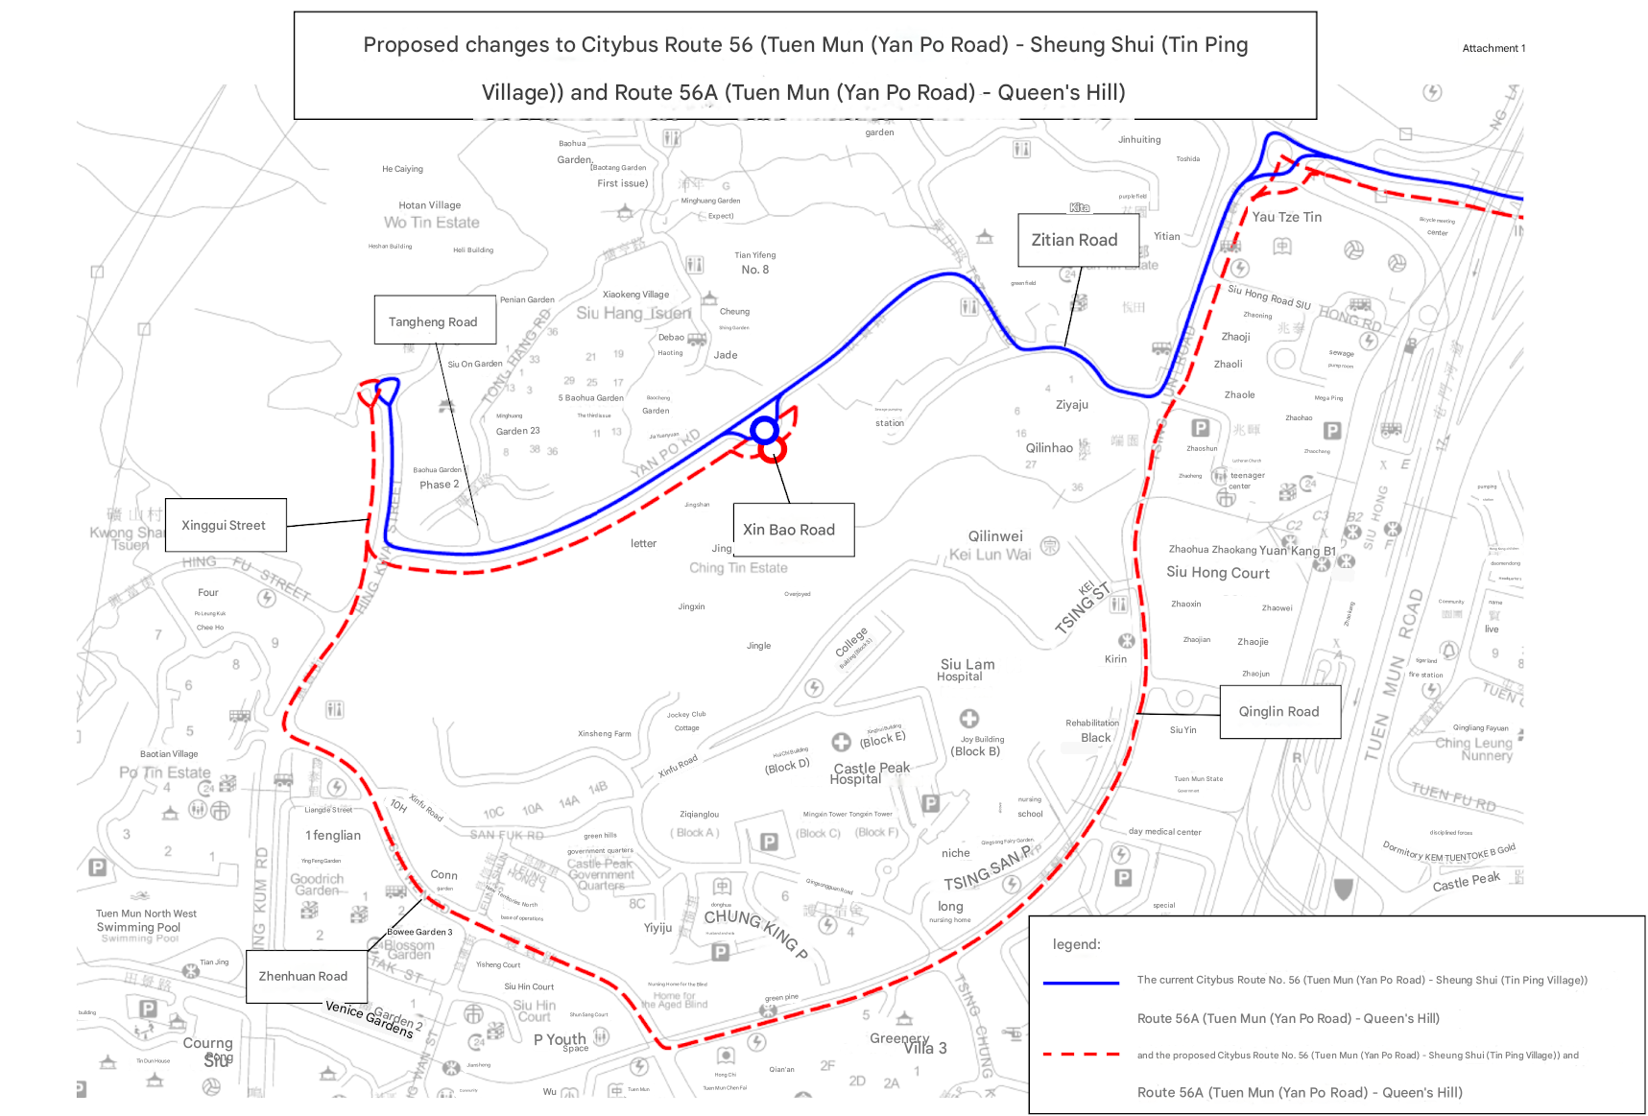
Yan Po Rd.

Slide 8
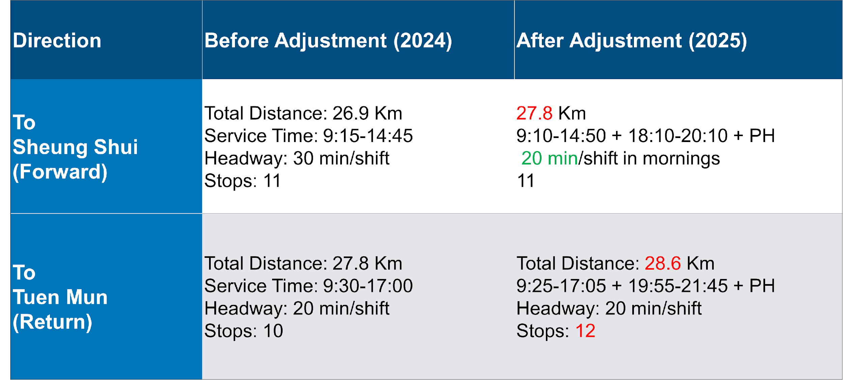

Slide 9
Objectives
To develop and analyze a simulation of Bus Route 56 operations during the morning using field data and estimated arrival times (ETA) from https://data.gov.hk/en/.
To assess the justification for route and frequency adjustments to Bus No.56 by estimating the seat utilization rate via simulation.
To provide evidence-based policy enquiries.

Slide 10
Recall simulation design
Simulation is about mimicking (complex) systems, normally over time, using logic, math and computers.
Simulation is an experimental process – run and rerun a model many times under different scenarios to predict system behaviour and evaluate performance under each scenario.
https://poe.com/Bus56

Slide 11
Random components
To calculate the seat utilization rate, we need to count the passengers on bus at each stop.
The travel time between each pair of stops is random.
At each stop, the number of waiting passengers is random.
At each stop, the number of passengers getting off is random.

Slide 12
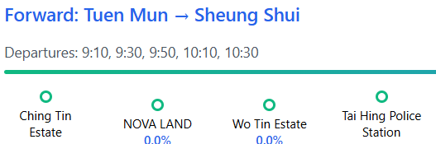
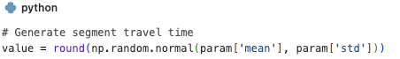
Travel time
The bus travel time between each pair of stops is modelled as a random variable drawn from a normal distribution, with the mean and standard deviation estimated from sample data.
Using the API, we collected ETA at each stop for 30 trips of Bus No. 56.
We then calculated the mean and standard deviation of travel times between each pair of stops. For each simulation run, we sampled travel times from the corresponding normal distributions to represent the bus travel times between stops.

Slide 13
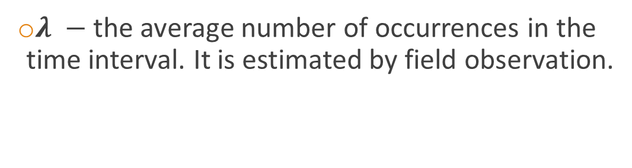
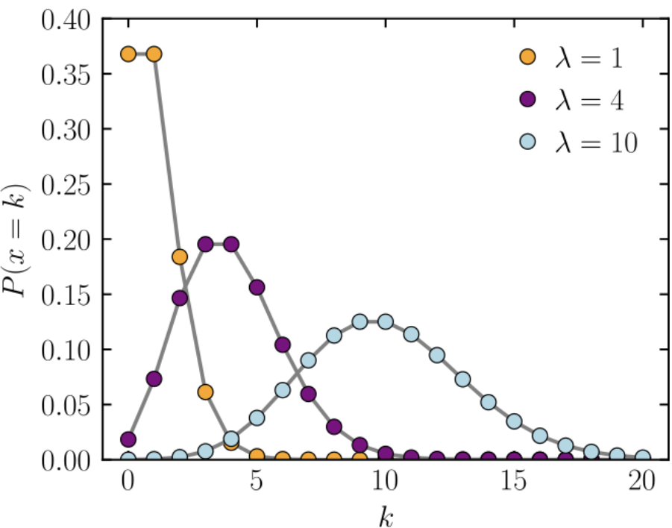
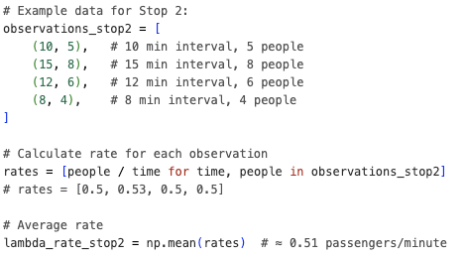
Number of waiting passengers
The number of waiting passengers at each stop is modelled as a random variable drawn from a Poisson distribution.

Slide 14
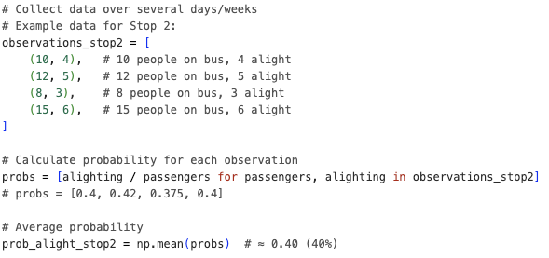
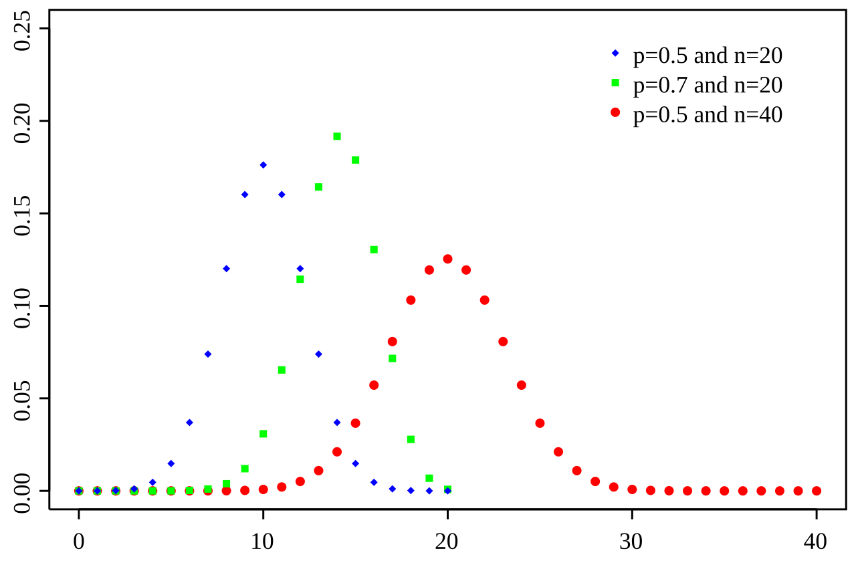
Number of passengers getting off
The number of passengers getting off at each stop is modelled as a random variable drawn from a Binomial distribution.

Slide 15
SimPy
SimPy is a discrete-event simulation framework.
Each event represents a specific action (e.g., bus arrival, passenger boarding, bus departure after dwell time).
Events are processed in chronological order according to their scheduled time, and only when they occur.

Slide 16
A typical SimPy structure
Steps | Python code
1. Create a SimPy environment | env = simpy.Environment()
2. Define a generator function | def bus_trip(env, run_number, bus_id, route_config, passenger_data) yield env.timeout(travel_time) To pause the process for a specified duration, allowing simulated time to advance.
3. Add the generator function to a SimPy environment | env.process(bus_trip(env, run_number))
4. Run the simulation and let time pass | env.run() To execute the simulation by processing all scheduled events until completion
Record the current time whenever an event happens env.now

Slide 17
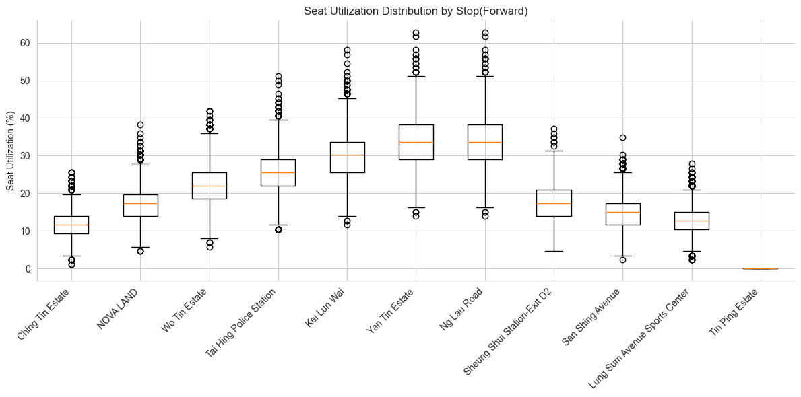
Result - existing forward (after adjustment)
In 1000 simulations:
Median of seat utilization:
12% - 34%

Slide 18
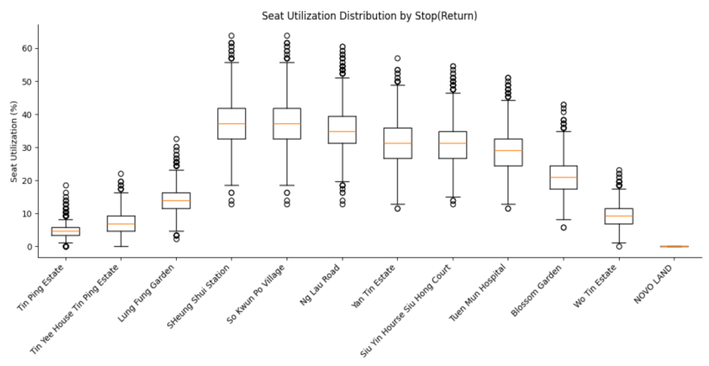
Result - existing return (after adjustment)
In 1000 simulations:
Median of seat utilization:
5% - 34%

Slide 19
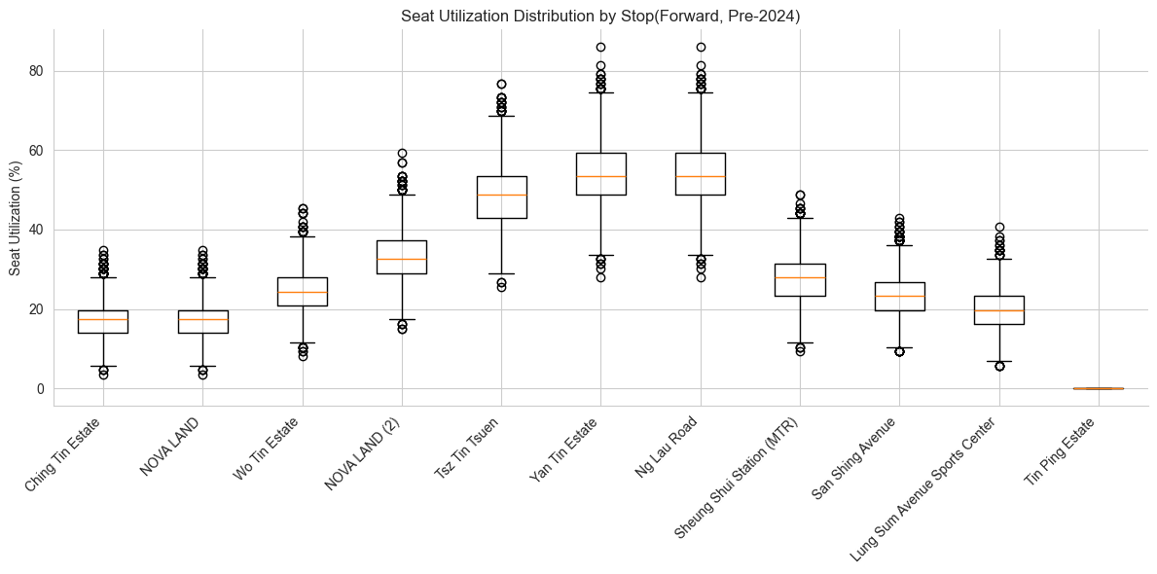
Result – forward, before adjustment
In 1000 simulations:
Median of seat utilization:
18% - 56%, based on estimated passenger flow at the removed bus stops.
Passenger flow data based on assumptions

Slide 20
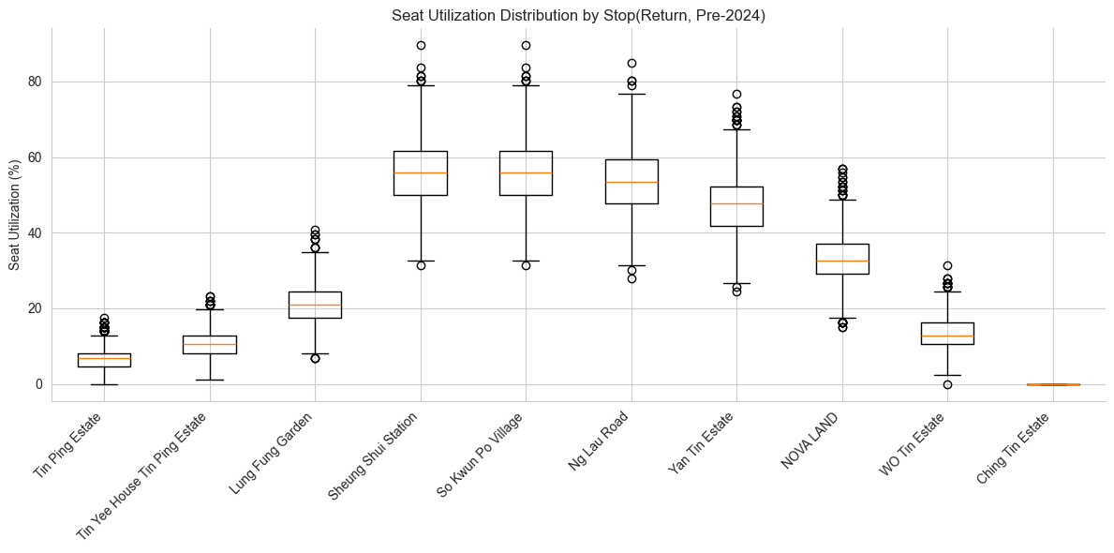
Result – return, before adjustment
In 1000 simulations:
Median of seat utilization:
8% - 58%
Passenger flow data based on assumptions

Slide 21
Result - Summary
The adjustment appears to have reduced the overall seat utilization rate.
But the decision to increase bus frequency should also be analysed from the perspective of operating costs.

Slide 22
Enquiry to Transport Department
1. Operational and Passenger Flow Data:
What types of operational and passenger flow data (e.g., stop-level boarding and alighting, peak/off-peak passenger counts) were collected and analyzed when assessing the rerouting and schedule changes for Routes 56?
2. Service Quality Evaluation:
What quantitative models or criteria were used to evaluate whether the service modifications would maintain or improve passenger service quality?
3. Data Accessibility:
Are the relevant operational datasets, consultation summaries, or evaluation models available for public or academic review? If so, how can these be accessed? If not, would the Transport Department consider releasing anonymized or summarized data in accordance with the Code on Access to Information?

